Slide 1
IBAMR Lecture 7 - Looking at ConstraintIB examples of prescribed and rigid body motion

Slide 2
Constraint IB Examples
A unified mathematical framework and an adaptive numerical method for fluid–structure interaction with rigid, deforming, and elastic bodies
Amneet Pal Singh Bhalla, Rahul Bale, Boyce E. Griffith, Neelesh A. Patankar
This paper is on the google drive. Note that it is the first paper for rigid body simulations.
Nearly all of the examples considered in this paper appear in these Constraint IB examples. Some examples are also similar to the CIB ones.
Some of the examples generate HUGE numbers of files.

Slide 3
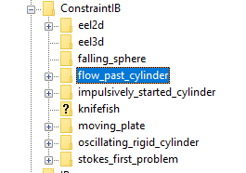
Constraint IB Examples

Slide 4
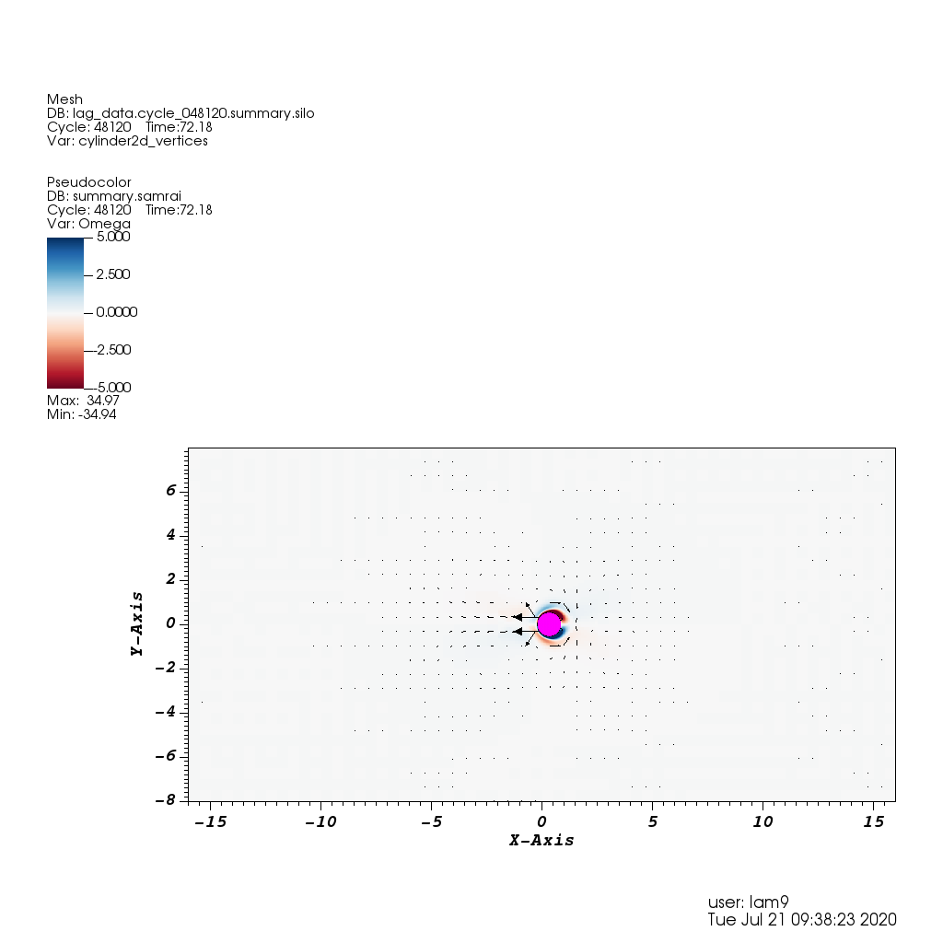
Constraint IB example – oscillating_rigid_cylinder
This is a prescribed motion example from 7.1.4.
“In cases in which the body has a nonconstant specified velocity, contributions to the drag forces come from both inertial and constraint forces. In this example, we consider a rigid circular cylinder oscillating about a mean position in a quiescent fluid.”

Slide 5
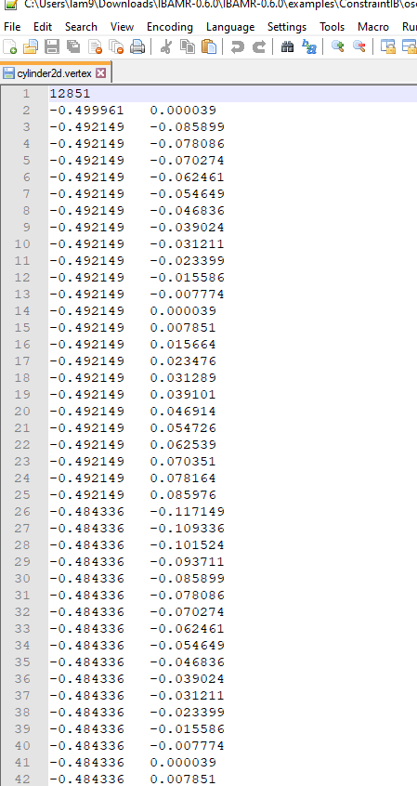
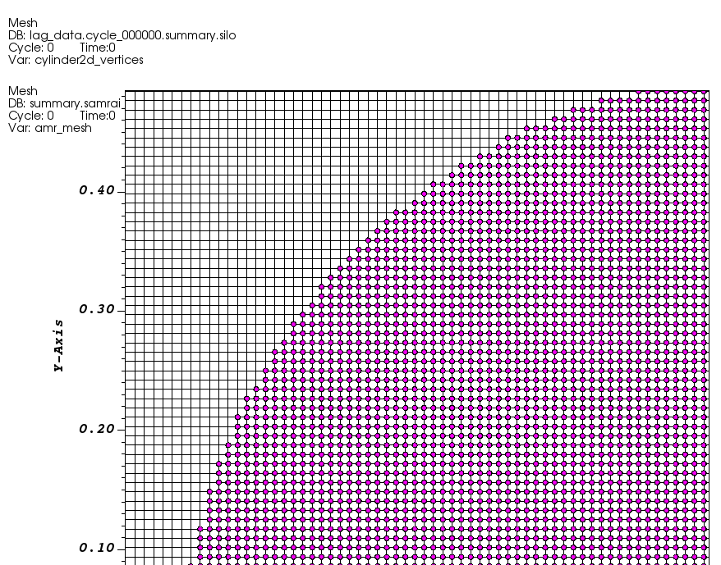
2dcylinder.vertex
The example includes a vertex file that gives x, y coordinates of all vertices.
The MATLAB file Cylinder2d.m generates this list of vertices.
The cylinder is filled in and ds=dx.

Slide 6
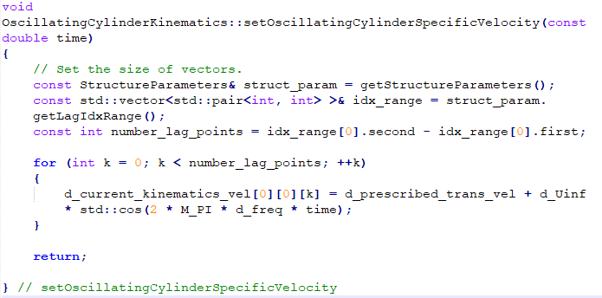
OscillatingCylinderKinematics.cpp
This file sets the prescribed motion of the cylinder.
Frequency and U_infinity (maximum speed of the cylinder) are read in from the input file.
d_current_kinematics_vel[0][0][k] – this refers to level 0 (should usually be 0), the component of velocity (0 is x), and k is the vertex number.
Be sure to include the header file when running simulations.

Slide 7
Alter the kinematics to make the cylinder go up and down
for (int k = 0; k < number_lag_points; ++k)
{
d_current_kinematics_vel[0][1][k] = d_prescribed_trans_vel + d_Uinf * std::cos(2 * M_PI * d_freq * time);
}

Slide 8
Input2d
// physical parameters
R = 0.5
Re = 100.0
MU = 2.0*R/Re
RHO = 1.0
// grid spacing parameters
MAX_LEVELS = 4 // maximum number of levels in locally refined grid
REF_RATIO = 4 // refinement ratio between levels
REF_RATIO_FINEST = 4 // refinement ratio for the finest level.
N = 16 // coarsest grid spacing
NFINEST = (REF_RATIO^(MAX_LEVELS - 1))*N // finest grid spacing
L = 16

Slide 9
Input2d ConstraintIB specific
// Oscillating Cylinder
ConstraintIBKinematics {
Cylinder {
structure_names = "cylinder2d"
structure_levels = MAX_LEVELS - 1
calculate_translational_momentum = 0,0,0
calculate_rotational_momentum = 0,0,0
lag_position_update_method = "CONSTRAINT_VELOCITY"
tagged_pt_identifier = MAX_LEVELS - 1, 0 // level, relative idx of lag point
// Cylinder oscillates with U_infinity * cos(2*pi*freq*t)
frequency = 0.2
U_infinity = 1.0
// Additional prescribed velocity
prescribed_trans_velocity = 0.0
}}

Slide 10
Input2d – print output
PrintOutput {
print_output = TRUE //default false, if false nothing will be printed.
output_interval = 1 //default 1
output_drag_kinetic_energy = TRUE //default false, if false it will not be computed.
output_power = FALSE //default false, if false it will not be computed.
output_rig_transvel = FALSE //default false
output_rig_rotvel = FALSE //default false
output_com_coords = FALSE //default false
output_moment_inertia = FALSE //default false
output_dirname = "./cylinder_dump"
base_filename = "cylinder2d"
}

Slide 11
Example.cpp
// Headers for application-specific algorithm/data structure objects #include <ibamr/ConstraintIBMethod.h>
// Create major algorithm and data objects that comprise the
// application. These objects are configured from the input database
// and, if this is a restarted run, from the restart database.
Pointer<ConstraintIBMethod> ib_method_ops = new ConstraintIBMethod( "ConstraintIBMethod", app_initializer->getComponentDatabase("ConstraintIBMethod"), num_structures);

Slide 12
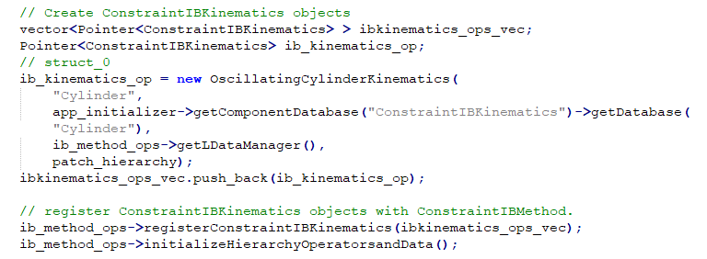
Example.cpp continued

Slide 13
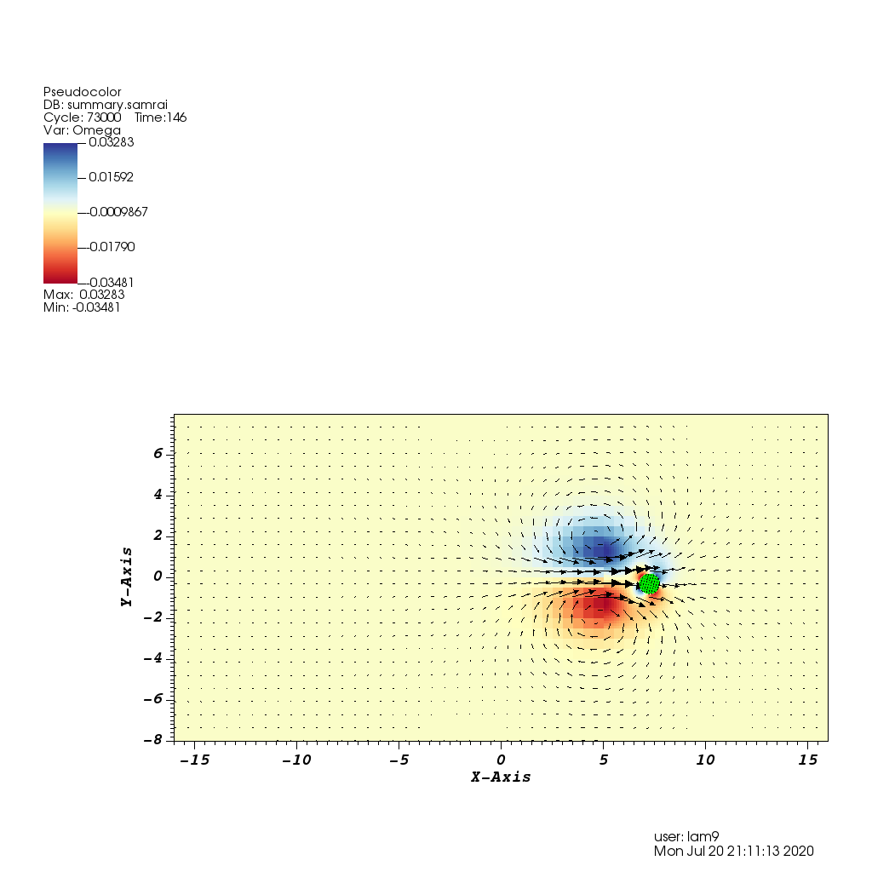
Constraint IB – impulsively_started_cylinder
This example appears in the paper in section 7.2.2.
“We take the case of impulsively started cylinder in a quiescent flow to demonstrate the momentum-conservation properties of our method. A cylinder of diameter D = 1 m is placed the center of a periodic domain of size 32 m x 16 m at time t = 0. An impulse of the form I(t) = 400 exp(-400t) N/m^3 is applied in the x direction within the body, at its initial position, thereby impulsively starting its motion.
This is an example of rigid body motion.

Slide 14
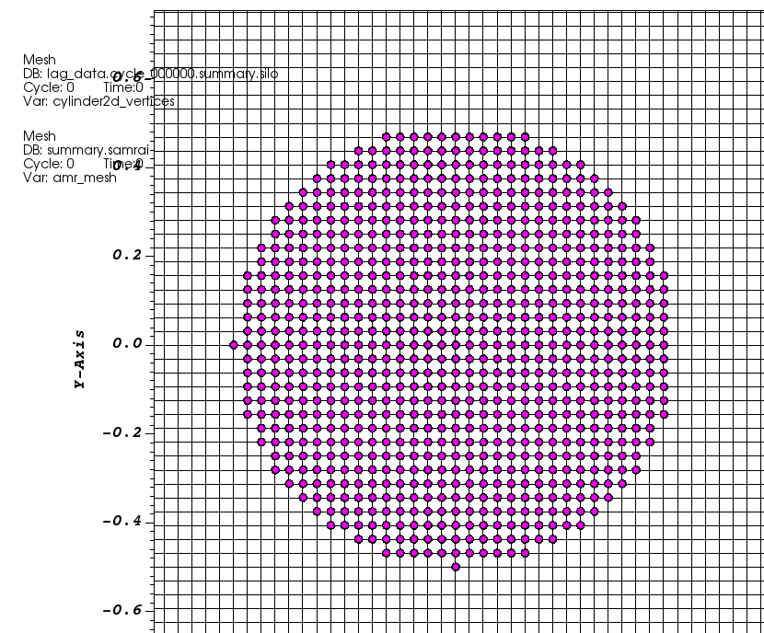
Cylinder2d.vertex
As before, contains a list of x,y coordinates of the vertices.
Spacing is dx=ds.

Slide 15
RigidBodyKinematics.cpp
This file is used to determine the rigid body motion of the cylinder.
An applied force that decays over time is applied to the cylinder.
The center of mass is calculated as well as the translational and rotational momentum. This is used to update the position of the immersed boundary.
Remember to include RigidBodyKinematics.h

Slide 16
Input2d – set for rigid body motion
ConstraintIBKinematics {
Cylinder2d {
structure_names = "cylinder2d"
structure_levels = MAX_LEVELS - 1
calculate_translational_momentum = 1,1,0
calculate_rotational_momentum = 0,0,1
lag_position_update_method = "CONSTRAINT_VELOCITY"
tagged_pt_identifier = MAX_LEVELS - 1, 0 // level, relative idx of lag point
kinematics_velocity_function_0 = "0.0"
kinematics_velocity_function_1 = "0.0"
}}

Slide 17
Applied force from input2d and example.cpp
ForcingFunction {
XCOM = 0.0
YCOM = 0.0
RADIUS = R
F = RHO/DT_MAX
function_0 = "(X0 - XCOM)^2 + (X1-YCOM)^2 < RADIUS^2 ? 400*exp(-400*t) : 0"
function_1 = "0.0“
}
// Create Eulerian body force function specification objects.
if (input_db->keyExists("ForcingFunction"))
{
Pointer<CartGridFunction> f_fcn = new muParserCartGridFunction(
"f_fcn", app_initializer->getComponentDatabase("ForcingFunction"), grid_geometry);
time_integrator->registerBodyForceFunction(f_fcn);
}

Slide 18
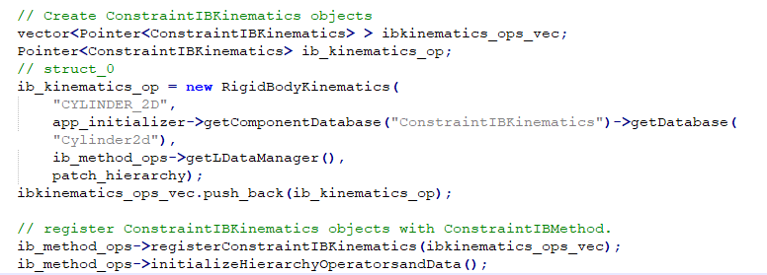
Other relevant parts of example.cpp
Pointer<ConstraintIBMethod> ib_method_ops = new ConstraintIBMethod( "ConstraintIBMethod", app_initializer->getComponentDatabase("ConstraintIBMethod"), num_structures);

Slide 19
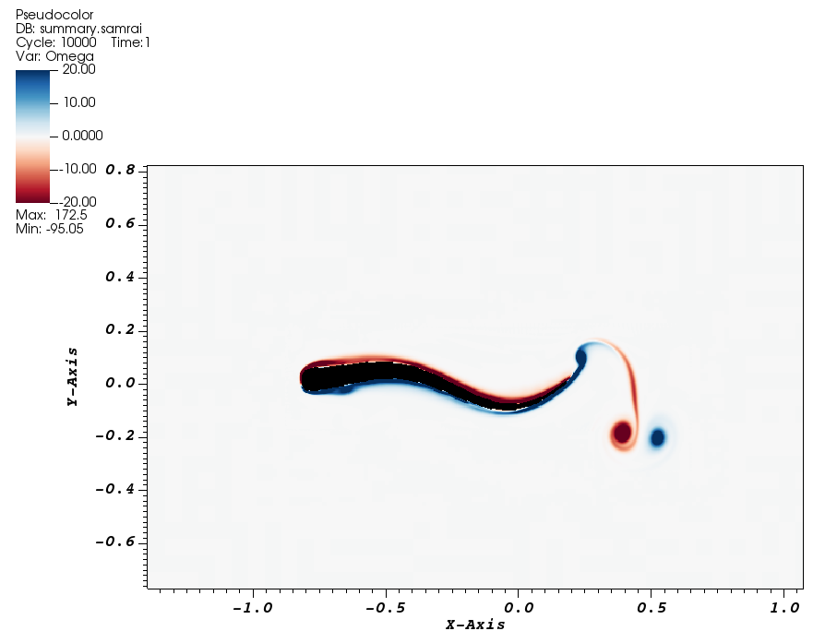
ConstraintIB – eel2d
In this example, the body deforms in a prescribed manner but is propelled through the water due to rigid body motion.
The center of mass is calculated at each time as well as the translational and rotational momentum. This is used to update the position.

Slide 20
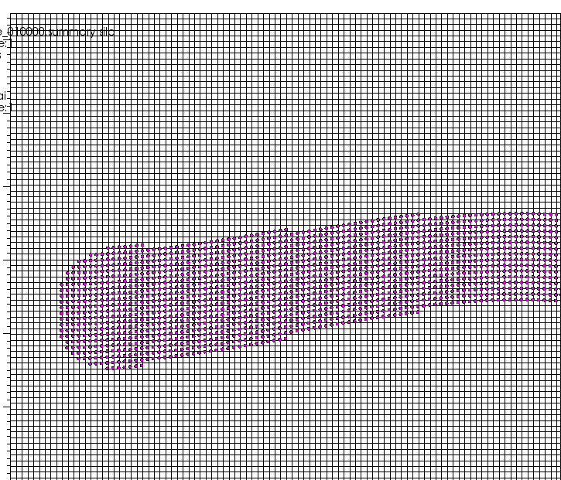
eel2d_straightswimmer
This is a MATLAB code that generates the vertices for the eel.
Eel2d.vertex is the output file.

Slide 21
IBEELKinematics.cpp
The default just allows for straight swimming of the eel
The deformation of the body is prescribed.
The propulsion is based on rigid body kinematics.
There are other functions for chasing a target / food, swimming in a circle, etc.
This makes the code a little harder to understand.
if (d_bodyIsManeuvering) – eel is maneuvering (turned off now)
In such cases, the maneuver axis is used to transform the body.
Deformation velocity functions are read in from the input file.
Center of mass is calculated at each time.

Slide 22
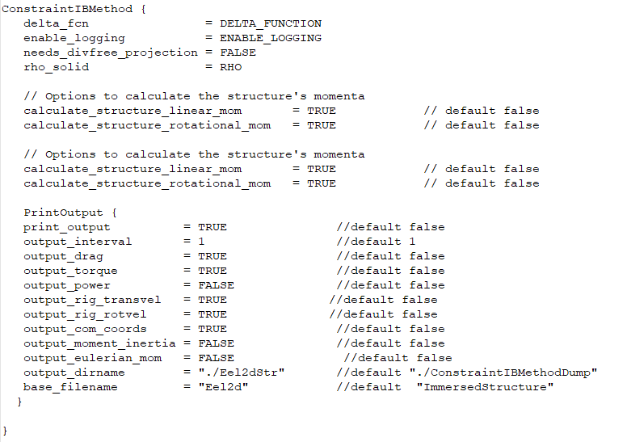
Input2d – Constraint IB Method

Slide 23
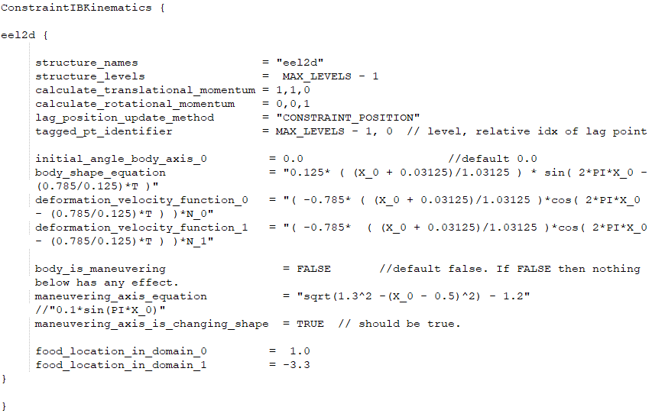
Input2d – body shape equation

